Slide 1
Gubernija brewery
2020

Slide 2
About us
01

Slide 3







GUBERNIJA – PART OF MV GROUP
STUMBRAS, ALITA, ANYKŠČIŲ VYNAS,
GUBERNIJA IN SIAULIAI
MINERALINIAI VANDENYS, MV LATVIA, MV EESTI,
MV POLAND
GUBERNIJA – one of the oldest brewery in Lithuania.
It is located in the fourth largest city in our country – Siauliai.
Since 2018 Gubernija is part of MV GROUP, one of the largest business groups in Baltic countries.
BOTTLERY NESPRESSO

Slide 4
GUBERNIJA overview
02

Slide 5
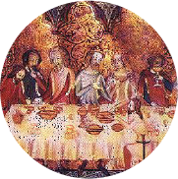
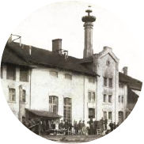
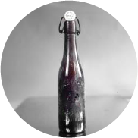
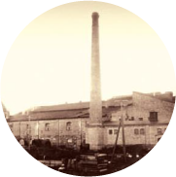



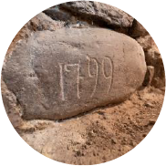

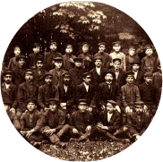
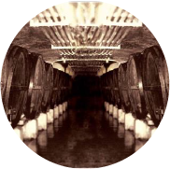

Our History
It is believed that
GUBERNIJA began its story this year as a small manor brewery, that brew ed beer that well that it was supplied to the royal table.
The GUBERNIJA brewery is officially established. It employs seven people and produces 20,000 buckets of beer per year.
First international award.
The Russian porter is recognized as
the best beer at the St. Petersburg exhibition.
After the demolition in 1914, the beer brewery joint stock company GUBERNIJA
is rebuilt and continues its activity.
The modern brewery begins to produce bread kvass from specially baked and toasted bread. The authentic recipe remains unchanged to this day.
1665
1867
1900
1922
1999
1799
1864-1904
1907
1937
2019
The brewery managed by Count N. N. Zubov is reconstructed and
a brewer from abroad settles in the brewery.
During the period of the press ban GUBERNIJA became the center of
Lithuanian culture Lithuanian books were hidden in its cellars, and secret meetings of intellectuals took place there.
Expansion.
47 workers make 250,000 buckets of beer a month.
A huge fire breaks out, but this does not stop beer production. GUBERNIJA produces more than 1,500,000 liters per year.
GUBERNIJA is renewed
and bravely continues the history of real brewing.

Slide 6
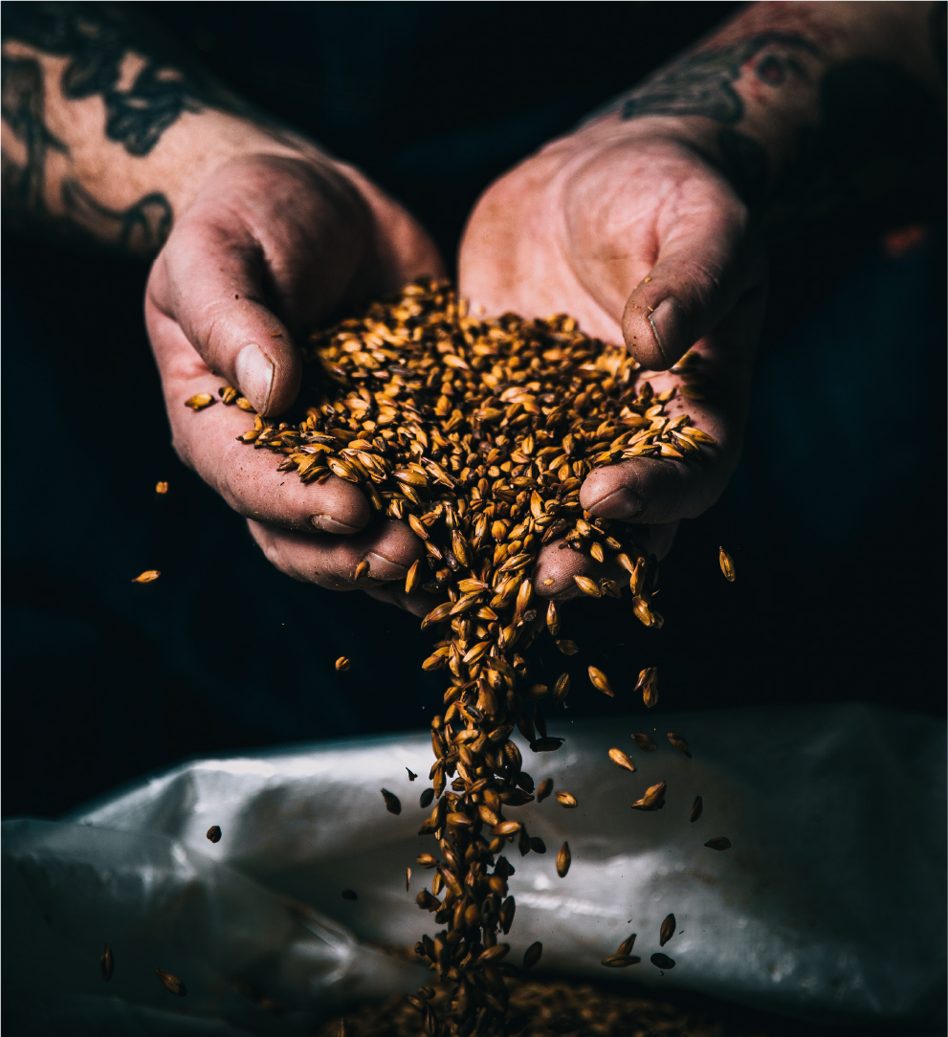

Our Values
Heritage
Mastership and excellence
Naturalness and authenticity
Freedom and courage

Slide 7
Exclusiveness
03

Slide 8
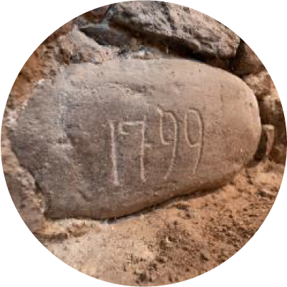

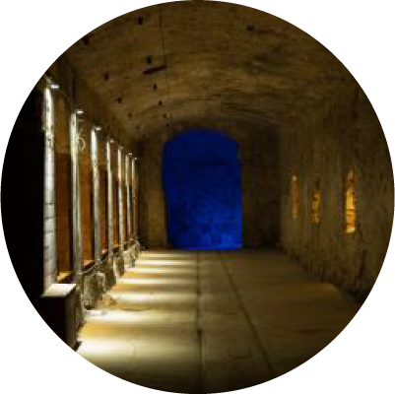


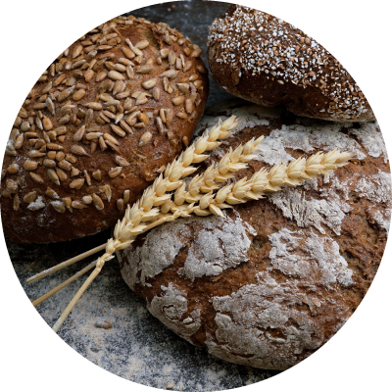
Interesting Facts
The main building construction date remains carved on the cornerstone 1799.
Our employee Juozas Vinča was the first Lithuanian boxer to achieve significant international victories and popularized the sport across the country
Our cellars have been declared a cultural heritage object
Since 1922, when the brewery was named GUBERNIJA, its logo has been changed 11 times, but the image of a goat has always remained.
During the press ban Lithuanian books were hidden and secret gatherings of “book carriers“ took place here
GUBERNIJA bread kvass is made from specially baked bread rusks

Slide 9
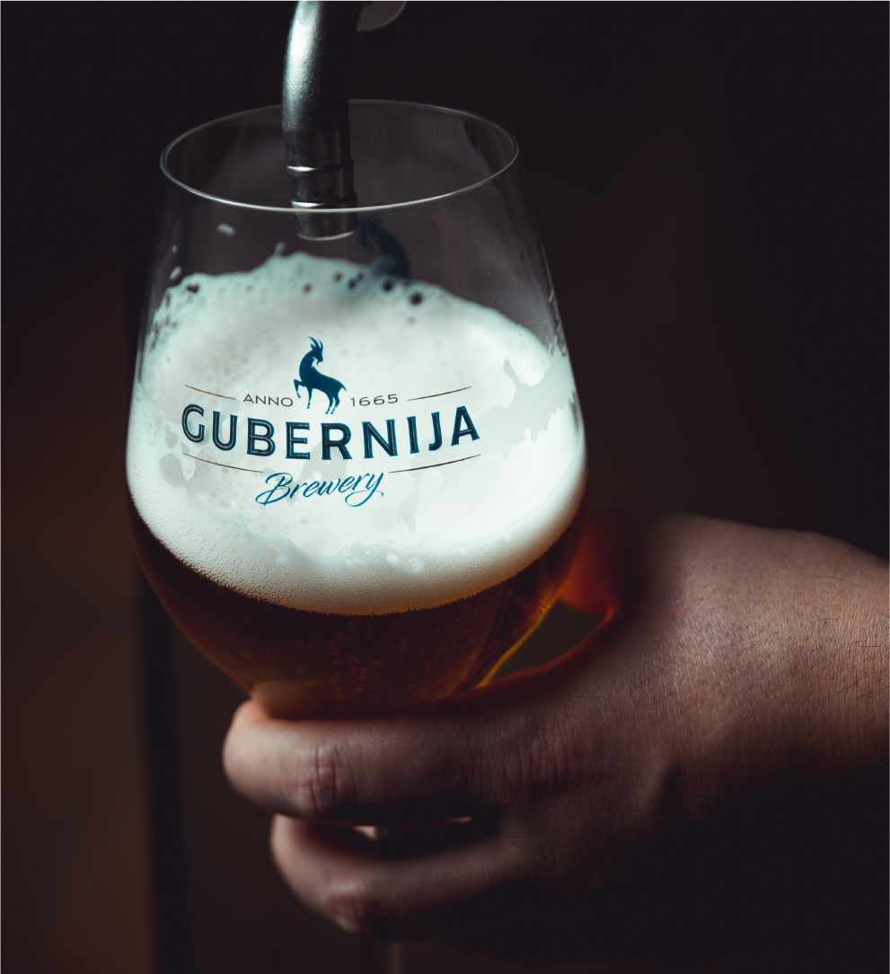

GUBERNIJA
Today
Centuries old Lithuanian brewery cherishes traditions and today is famous for it‘s beers, especially ales, and bread kvass.
Only high quality raw materials.
Classic brewing technology.

Slide 10
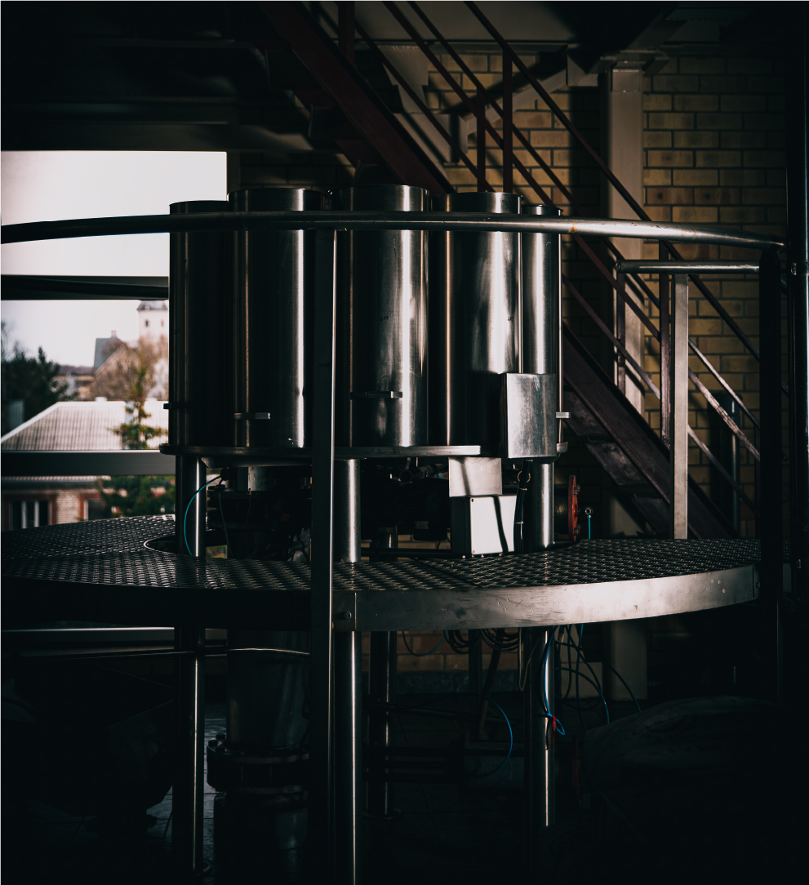
Production Capacity
Has about 160 SKUs in the present portfolio.
Operates 4 bottling lines.

Slide 11
Thank You
Dvaro g. 179
LT-76176 Siauliai LITHUANIA
+370 41 591900
gubernija.lt gubernija@mvgroup.eu
© 2020 AB, „MV GROUP Production“

